Slide 1

By: Tommy Demos

Slide 2

Call centers should solve problems
If customers are calling back multiple times…
…their problems aren’t being solved!

Slide 3
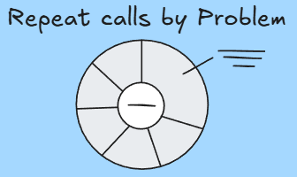
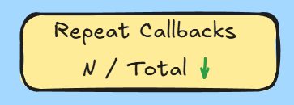
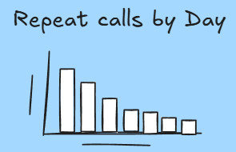
You have to track a problem to fix it!
Staying on top of changes in metrics will be important.
The most useful metrics aren’t actually that complex.
Visuals make it even easier to understand!

Slide 4
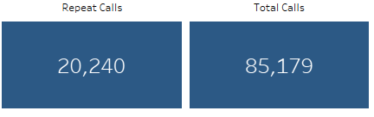
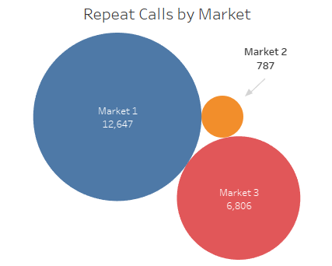
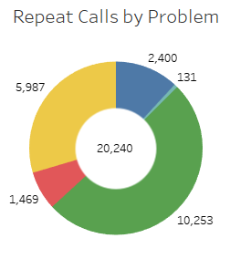
Most Useful Metrics
→Repeat Calls / Total Calls
Easily track movement
→Repeat Calls By Market
Highlight troubled areas
→Repeat Calls By Problem
See what's causing problems

Slide 5
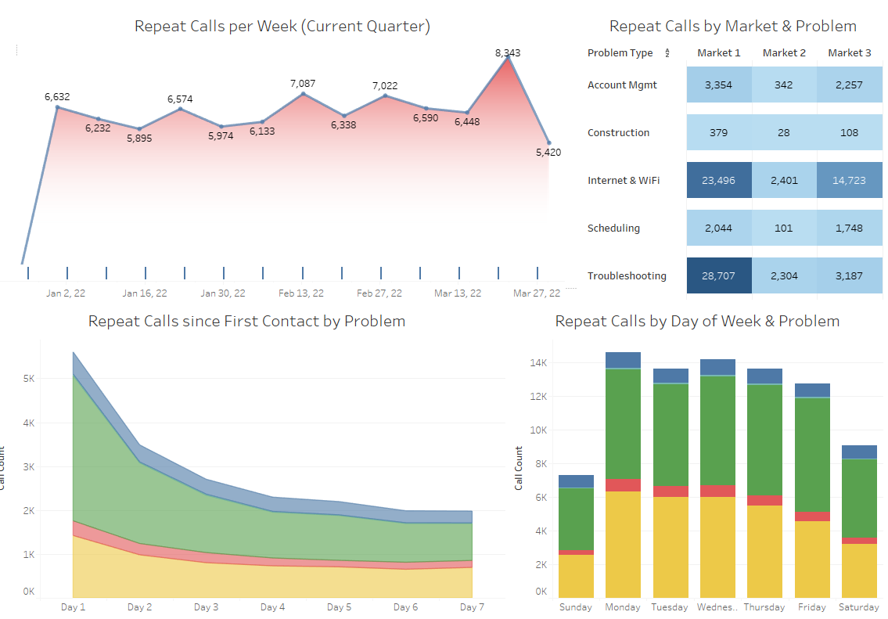
Drill Down Deeper!
Need to track weekly progress?
Curious how quickly problems are being addressed?
Want to know the days with the heaviest workload?
Just want to see the numbers?

Slide 6
Thank you!

